Slide 1
COVID-19 and the Cardiovascular System
Greg Lewis
Tom Neilan
March 18, 2020

Slide 2
Background: Coronavirus Infections
  Worldwide endemic viruses HCoV 229E, NL63, OC43, and HKU1 (Cause ∼20% URIs)
  2002: SARS-CoV (Severe Acute Respiratory Syndrome): ACE-2 binding lower resp tract
  2012: MERS-CoV (Middle East Respiratory Syndrome): DPP4 binding lower resp tract
  2019: COrona VIrus Disease 2019 (COVID-19): homology to SARS, ?ACE-2 binding
    First cases in Wuhan, Hubei Province in China, incubation 1-14 days, usual is 3-7
    Spreads by droplet, direct contact, fecal
Clinical Characteristics | COVID-19
Cough | 76-82
Fever | 45-98
SOB | 31-55
Mech Ventilation | 2-6%
Case-fatality | 1-2%
Paules….Fauci et al, JAMA 2020
Adapted from Guam et al, NEJM 2020
Notes:
dipeptidyl peptidase 4 (DPP4),

Slide 3
COVID-19 Clinical Course: N=191, 54 deaths
Zhou F, Lancet 2020

Slide 4
Risk Factors for Severe Disease
MGH ID COVID-19 Here and Now Treatment Guidance (MGH-ID-CHANT) March 17, 2020

Slide 5
COVID-19 and CVD
Guan et al, NEJM; Huang et al, Lancet; Wang et al, JAMA; Zhang et al, Allergy; Zhou et al, Lancet; Wu et al, JAMA IM
Nephjc.com

Slide 6
COVID-19 Epidemiology in Rapid Evolution
Zhou Lancet, March 2020

Slide 7
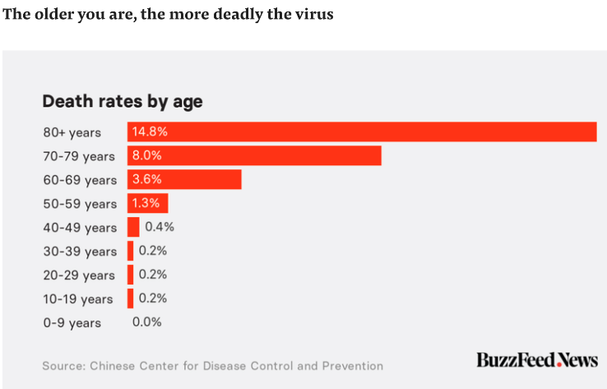
Mortality in COVID19

Slide 8
Current Exposures in Patients with CVD the ACE 2 Controversy
From MGH Cardiologist
Subject: Fwd: RAS blockers in COVID-19 - COMMUNICATION
What is our plan for our patients?
See below routed to me by my sister RE: XXXXX Medical Center Guidance

Slide 9
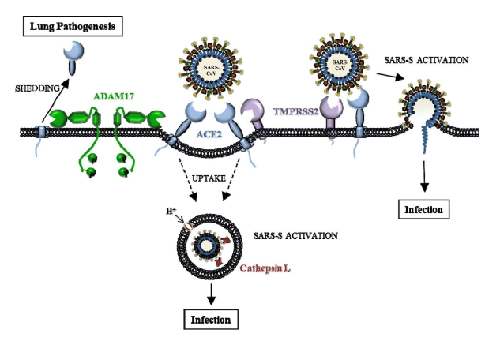
ACE 2 Controversy
ACE2 in lower respiratory tract pulmonary epithelium (also on intestine, heart and kidney)
Once infection, coronaviruses decrease ACE2 expression and this may be associated with more severe pulmonary infections

Slide 10
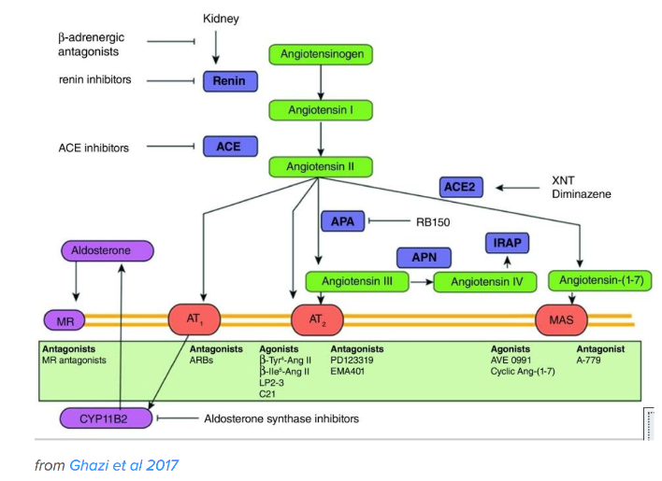
What is ACE2?
ACE2 converts AngII (angiotenin II – main mediator in the RAAS system) to the vasodilatory Ang 1-7
NET EFFECT: VASODILATION (or Less vasoconstriction)

Slide 11
ACE2 – COVID
ACE2 expression increased with:
  Type 1 or type 2 diabetes
  ACE inhibitors and angiotensin II type-I receptor blockers (ARBs)?
    Normotensive Lewis rats: YES (Ferrario et al in Circulation (2007)
    Rat study with coronary ligation: YES (Ishiyama et al in Hypertension (2004)
    Humans: study in EP Europace (2017) NO increase in circulating ACE2
  Thiazolidinediones?
  Ibuprofen?

Slide 12
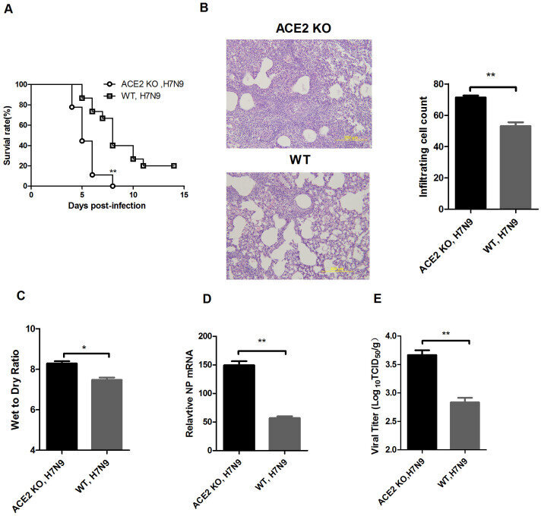
ACE 2 Knock
Out Mice
-Worse Pneumonia
Yang et al. Scientific Reports 2014

Slide 13

ACE 2 Controversy - Would increase pulmonary ACE2 be bad or good?
- Having MORE ACE2 is actually helpful for severe pulmonary infections
- ACE2 KO mice have more severe pulm infx
- Recombinant ACE2 is a potential treatment
Having MORE ACE2 could lead to increased susceptibility to viral entry
Losartan RCT in COVID-19 (inpatient and outpatient); University of Minnesota; NCT04311177

Slide 14
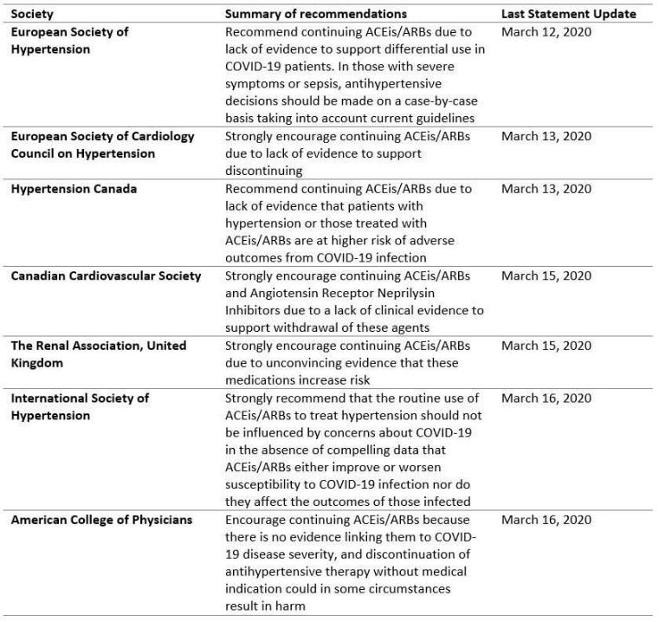
Current Consensus
Do not routinely stop ACE/ARB/ARNI
March 17, 2020
The AHA, the HFSA and the ACC recommend continuation of angiotensin converting enzyme inhibitors (ACE-i) or angiotensin receptor blocker (ARB) medications for all patients already prescribed for indications such as heart failure, hypertension or ischemic heart disease.

Slide 15
MGH ID CHANT Rx Approach

Slide 16
Statins in COVID-19
Attenuate Viral PNA
Reduce IL-6 Levels
Promote Innate Immune Responses
Annals of Intensive Care, 2012

Slide 17
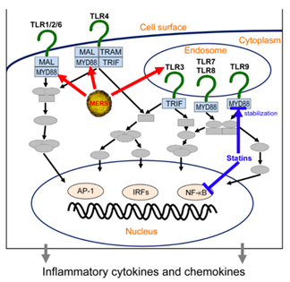
Statin Therapy in COVID-19
  MYD88 gene highly induced by SARS-CoV infection, activates the NF-kB pathway → marked inflammation
  Statins are known inhibitors of the MYD88 pathway
  Chronic dyslipidemia observed in SARS-CoV infected patients
Given the low chance of harm and the multiple possible benefits as described above, although there is no data, we recommend consideration of starting a statin on all patients with COVID-19 disease, particularly if they have a clear pre-existing primary indication.
    Transaminase elevations above 3 times the upper limit of normal occur in 0.7% of cases.
    -Hold statin for LFTs > 3X normal (permits other Rx)

Slide 18
MGH COVID-19 Therapies and the CV System
Hydroxychloroquine and Chloroquine:
  Malaria therapy
  Experience in China suggests anti-viral activity, 29 ongoing trials
  To be used in the MGH Rx Protocol for COVID-19
  Rare cardiotoxicity – related to chronicity (months-to-years, chlorquine > HCQ)
  Rare QTc prolongation –also typically in chronic users , check ECG x 1
Lopinavir and ritonavir:
  In China, first line – given to 90% - CHB and cardiomyopathy – rare
Interferon:
  Hypotension and myocarditis – not rare
AHA Statement: Medications Associated with Cardiotoxicity, Circulation 2012

Slide 19
MGH COVID-19 Therapies and the CV System
Chinese recommendation:
  “Therefore, during treatment of COVID-19, especially with the use of antivirals, the risk of cardiac toxicity must be closely monitored”

Slide 20
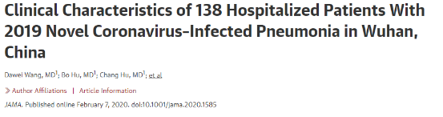
Cardiac Testing --- and trying to avoid additional testing/exposures
138 patients hospitalized patients with confirmed NCIP.
1/4 to ICU because of the development of organ dysfunction.
Median age 56 (22-92 years).
HTN in 31%
Diabetes in 10%

Slide 21
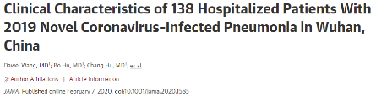
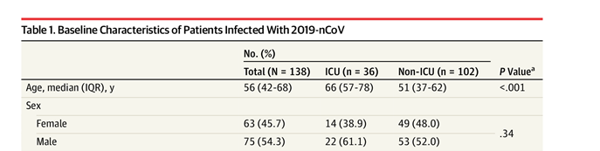
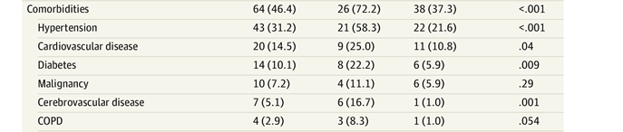
Cardiac outcomes/testing
1/4 to ICU because of the development of organ dysfunction.
Intubation: 47%
Common complications:
  Shock - 8.7%
  ARDS - 19.6%
  Arrhythmia - 16.7%
  Acute cardiac injury - 7.2-10%

Slide 22

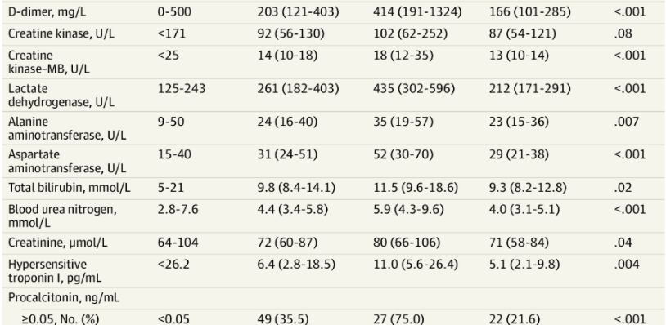
Biochemical abnormalities

Slide 23
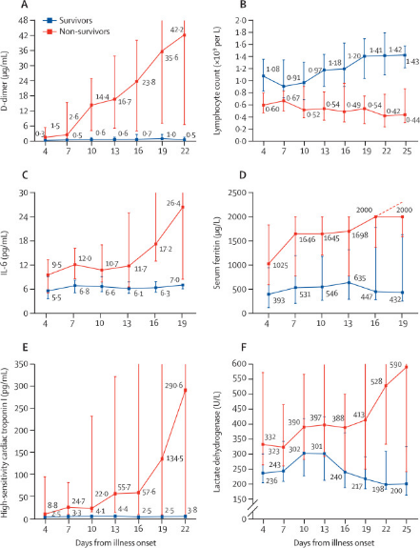
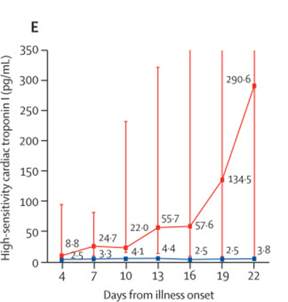
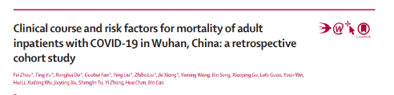
Troponin and outcomes with COVID-19

Slide 24
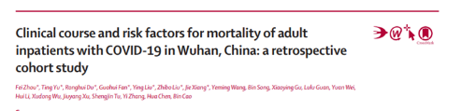
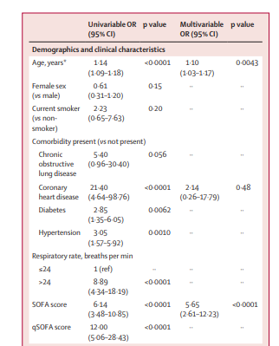
Predictors of outcomes

Slide 25
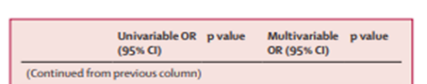
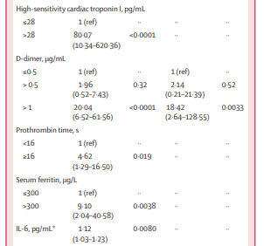
Biochemical predictors of outcomes

Slide 26
The “Myocarditis”/Myocardial Injury Story
Common themes for shock:
  Respiratory status improving
  About 1-2 weeks into illness
  Severe hemodynamic compromise
    Low level troponin but very low EF – more common
    High troponin but very low EF – less common.
  Conflicting data on whether this is myocarditis of a cytokine-mediated phenomenon.
  Early days but perhaps more likely a cytokine storm.

Slide 27
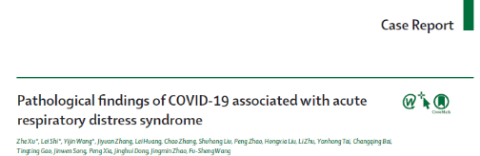
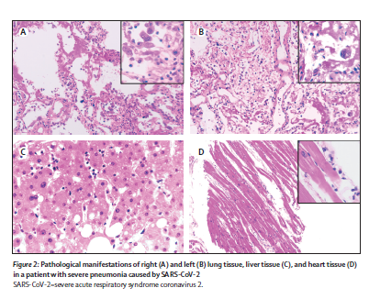
The “Myocarditis Story”

Slide 28
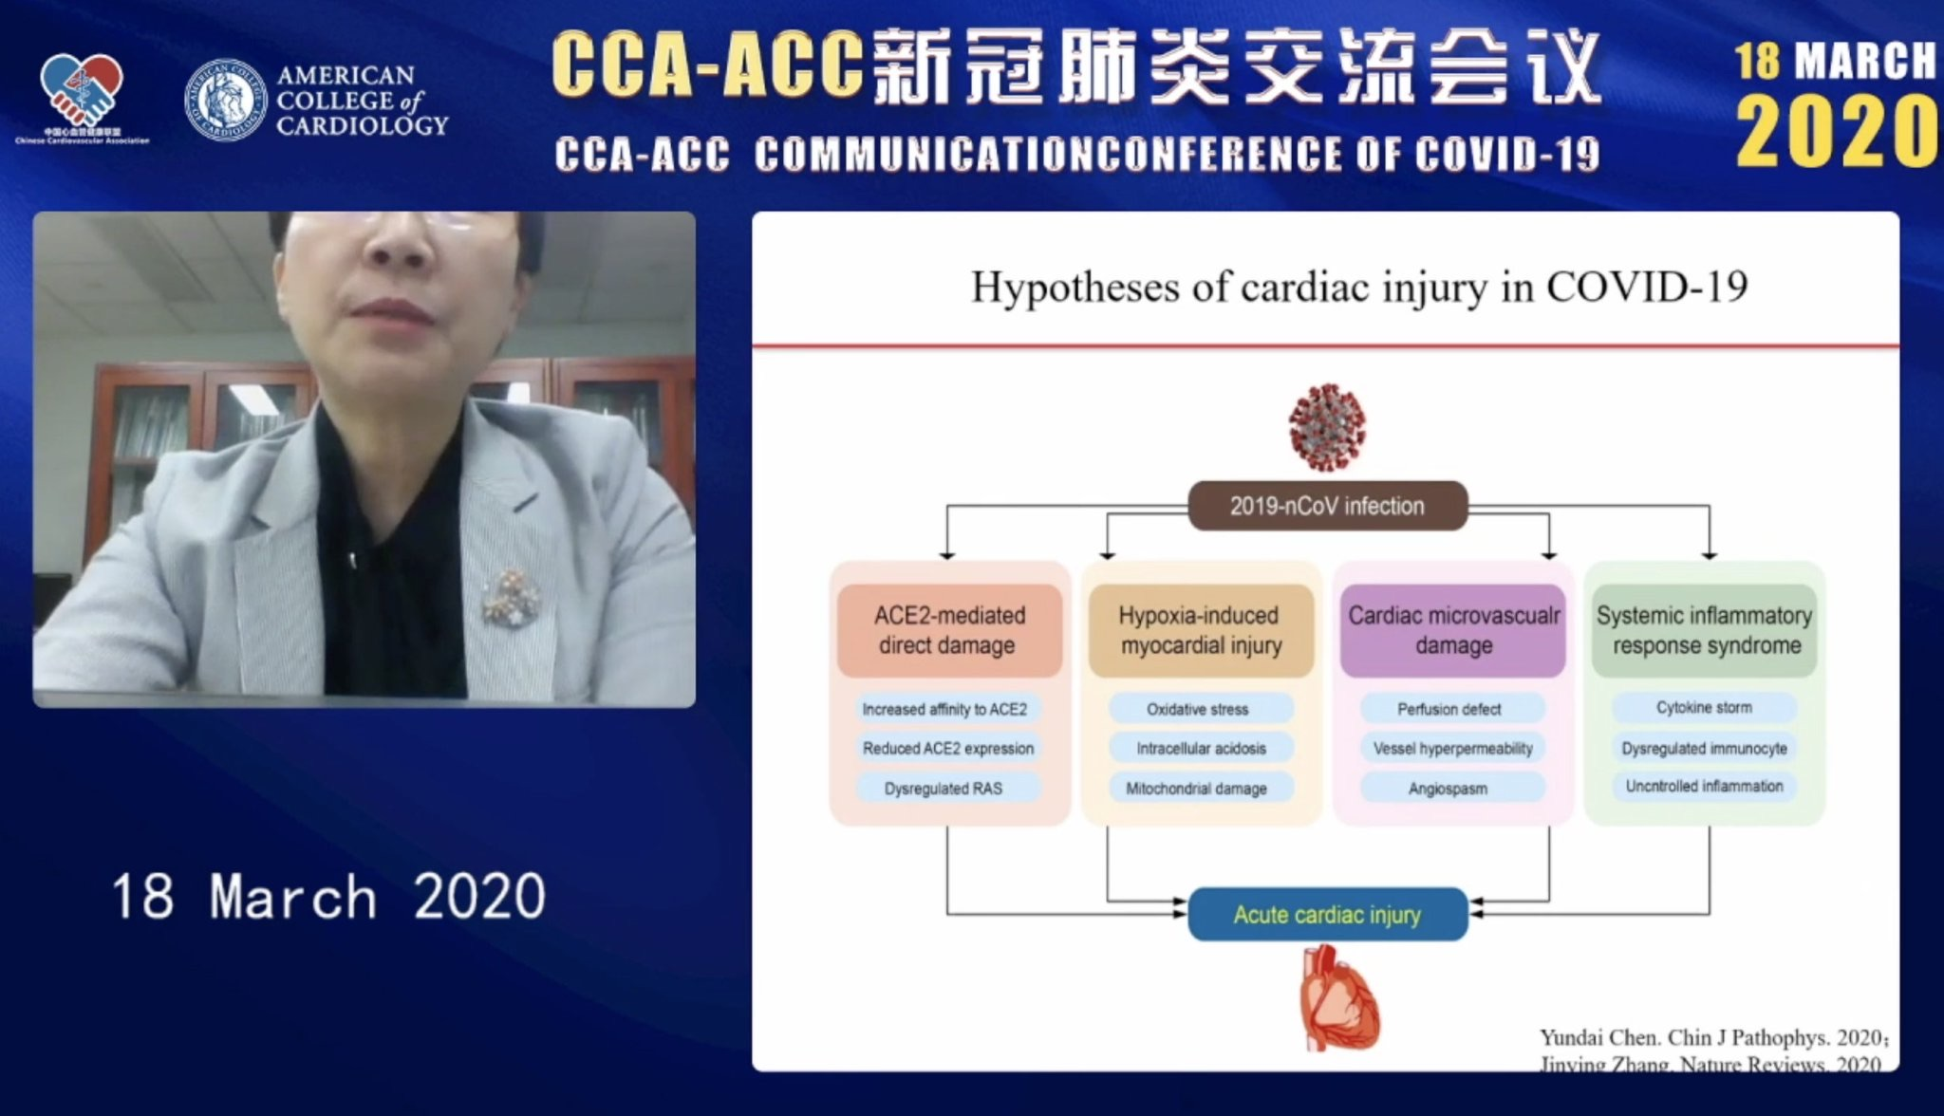
Mechanism of Cardiac Injury

Slide 29
Some initial suggestions
They will get routine troponins. That is already decided.
They will get routine EKGs. That is already decided.
What to do with an abnormal result (10-20% of patients)?
Two very key requirements:
  Not to increase exposure without compromising patient care – at least 3.5% of all cases are healthcare-related exposures (Italy 10-20%).
  Only test if it helps with patient care.

Slide 30
Some initial suggestions
Positive troponin:
  A detectable troponin does not trigger an echo or a cardiology consult.
  A detectable/elevated troponin (>30) and hemodynamic compromise will likely trigger an echocardiogram/POC ultrasound.
  POC ultrasound would have advantages of decreasing exposure.
  A detectable/elevated troponin (>30) but patient is fine, if needed, e-consult/phone call.

Slide 31
Some initial suggestions -EKG
Known/suspected COVID and abnormal EKG:
  Non-STE and well – thank you, nothing
  Non-STE and unwell (troponin will likely be detectable/up) – echo/POC US?
  STE and unwell ------- three cases, both normal coronaries so likely something else:
    Thrombolysis?
    It is something else?

Slide 32
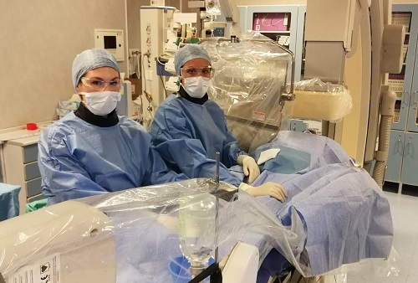
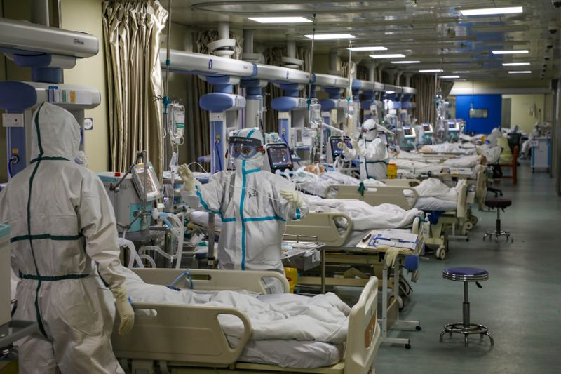
Some initial suggestions -EKG
What to do with the real STEMI and no obvious COVID?
  China – if well - thrombolysis

Slide 33
Hemodynamically unwell
What to do with those that are hemodynamically unwell with a decreased cardiac output:
  Shock team assessment?
  V-A ECMO- limited resources
  Impella and exposures

Slide 34
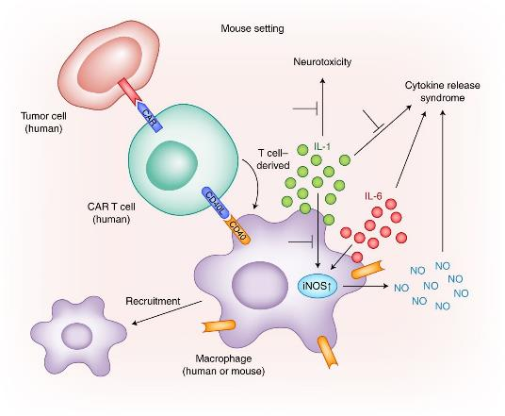
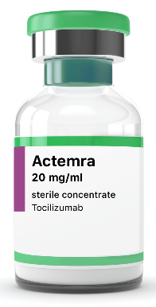
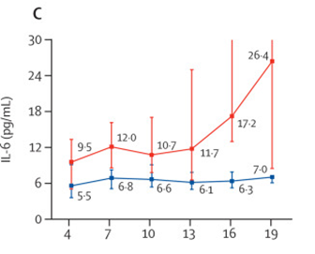
Other treatments?

Slide 35
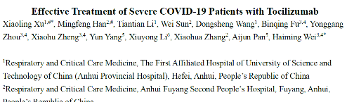
Treating the sickest with CV compromise- Toci?
Overview of Study:
  21 patients, Single center, 56.8 ± 16.5 years, 42% with HTN, 24% diabetes
Of the 21 patients, 17 patients (81.0%) were assessed as severe and 4 (19.0%) critical:
  High-flow oxygen therapy in 9 patients (45.0%)
  Nasal cannula in 7 patients (35.0%)
  Mask oxygen in 1 patient (5,0%)
  Noninvasive ventilation in 1 patients (5.0%)
  Invasive ventilation in 2 patients (10.0%).
  Mean IL-6 was 132.38 ± 278.54 pg/ml

Slide 36
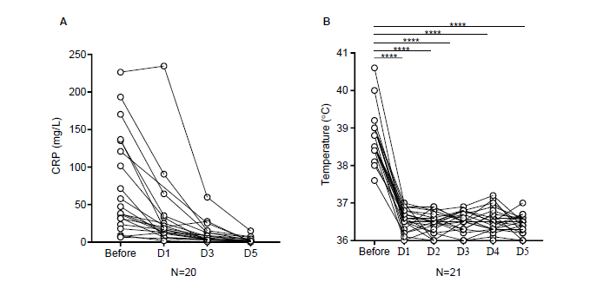
Treating the sickest with CV compromise- Toci?

